Slide 1

Finding optimal portfolio (S&P500)
FIN580. Advanced Data Science and Python for Finance
Aizhan Kassym-Ashim

Slide 2

Agenda
 | X
Introduction | X
Code explanation | X
Finding optimal portfolio | X
Optimization algorithm | X
Results | X
Conclusion | X

Slide 3

Introduction

Slide 4
Introduction
Our goal of this project is to find the optimal portfolio of all component stocks of S&P 500.
Largest Sharpe ratio
Assume short sales are not allowed

Slide 5
Code Explanation

Slide 6
Code Explanation
The Code Process
First Step
Second Step
Third Step
Reading csv file of all component stocks in S&P500, converting values to a list
Retrieving data for S&P500 stocks from Yahoo Finance.
Computing log returns, dropping NaN, and creating a dataframe of cumulative log returns.
Forming equal weighted portfolio
Creating a Numpy array named a1 and populate it with equal weights
Defining a function portfolio with one input parameter a1 (array of weights), that will return:
- annualized portfolio return
- annualized portfolio standard deviation
- sharpe ratio
Defining an objective function named neg_sharpe(weight) and sum_weight(weight)
Setting lower and upper bounds of each weight
Finding x to minimize the objective function
Finding ret, std, and sharpe ratio of the optimal portfolio
Plotting the weight dataframe to a bar plot

Slide 7
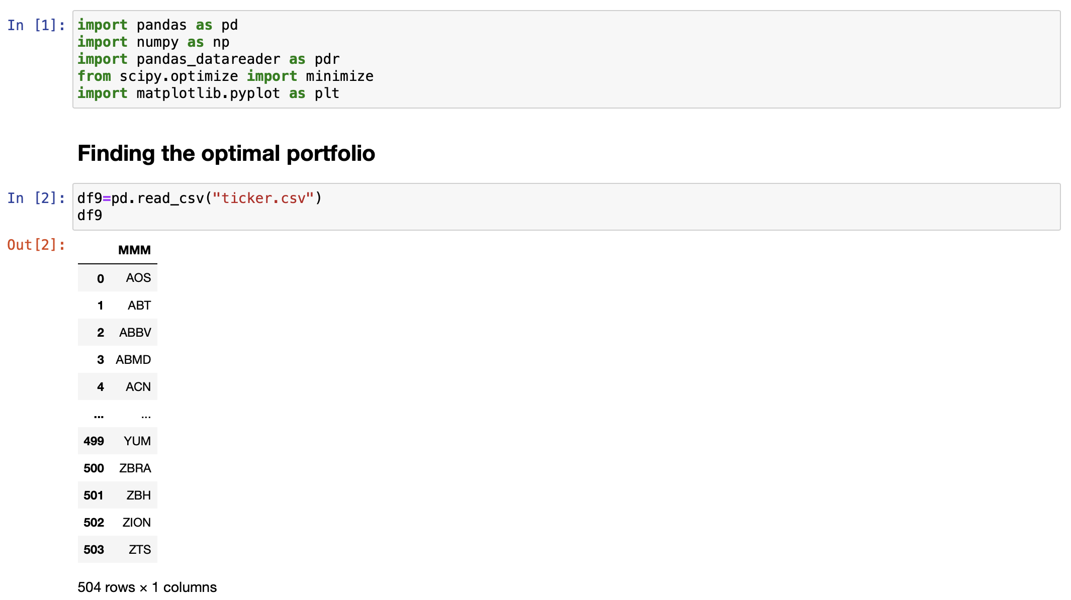
Code Explanation --- First Part

Slide 8
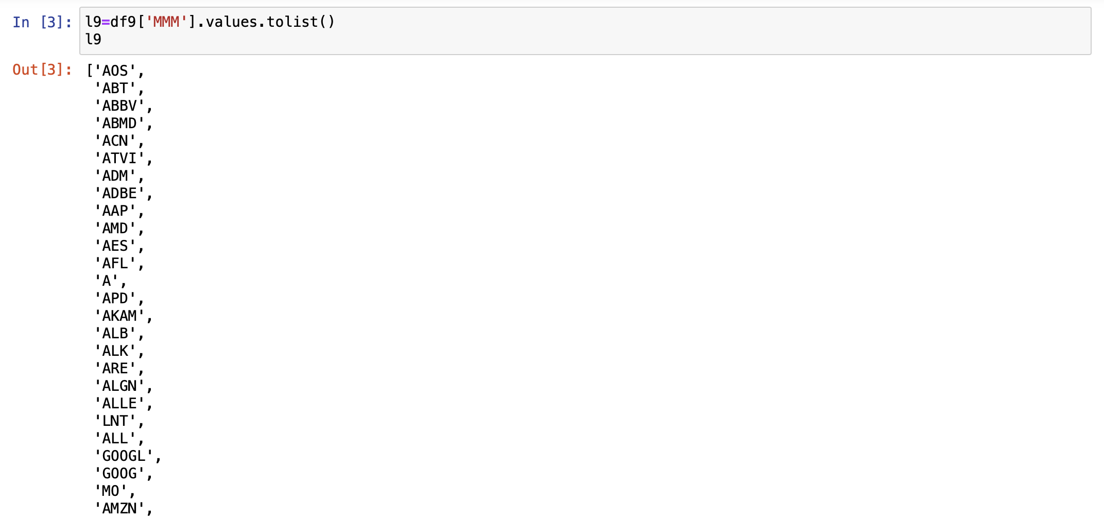
Code Explanation --- First Part

Slide 9
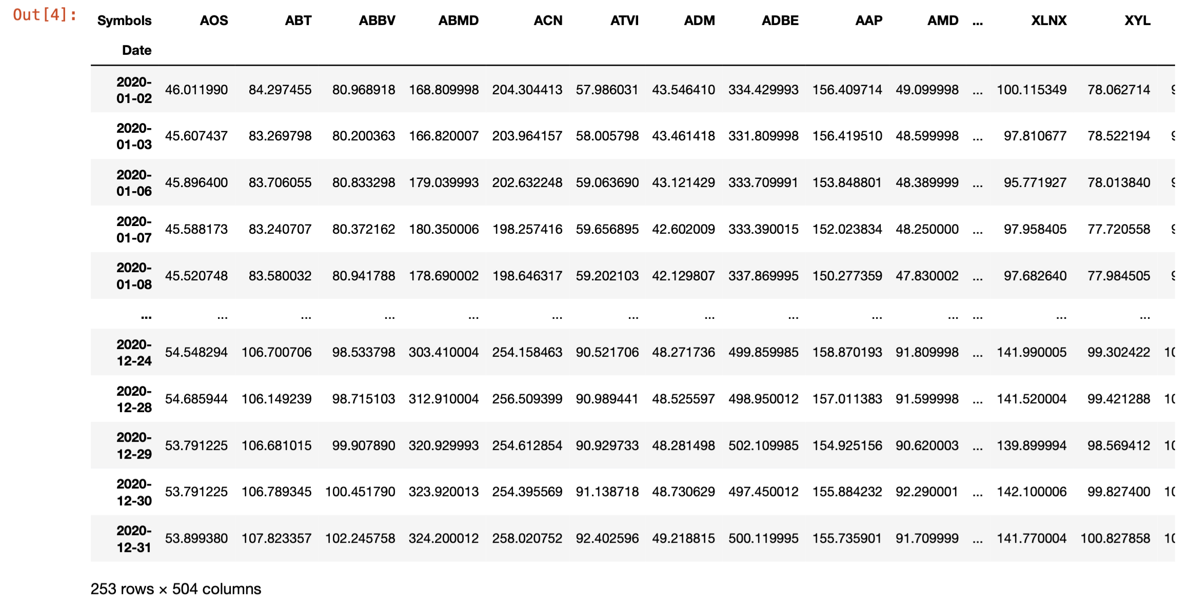
Code Explanation --- First Part

Slide 10
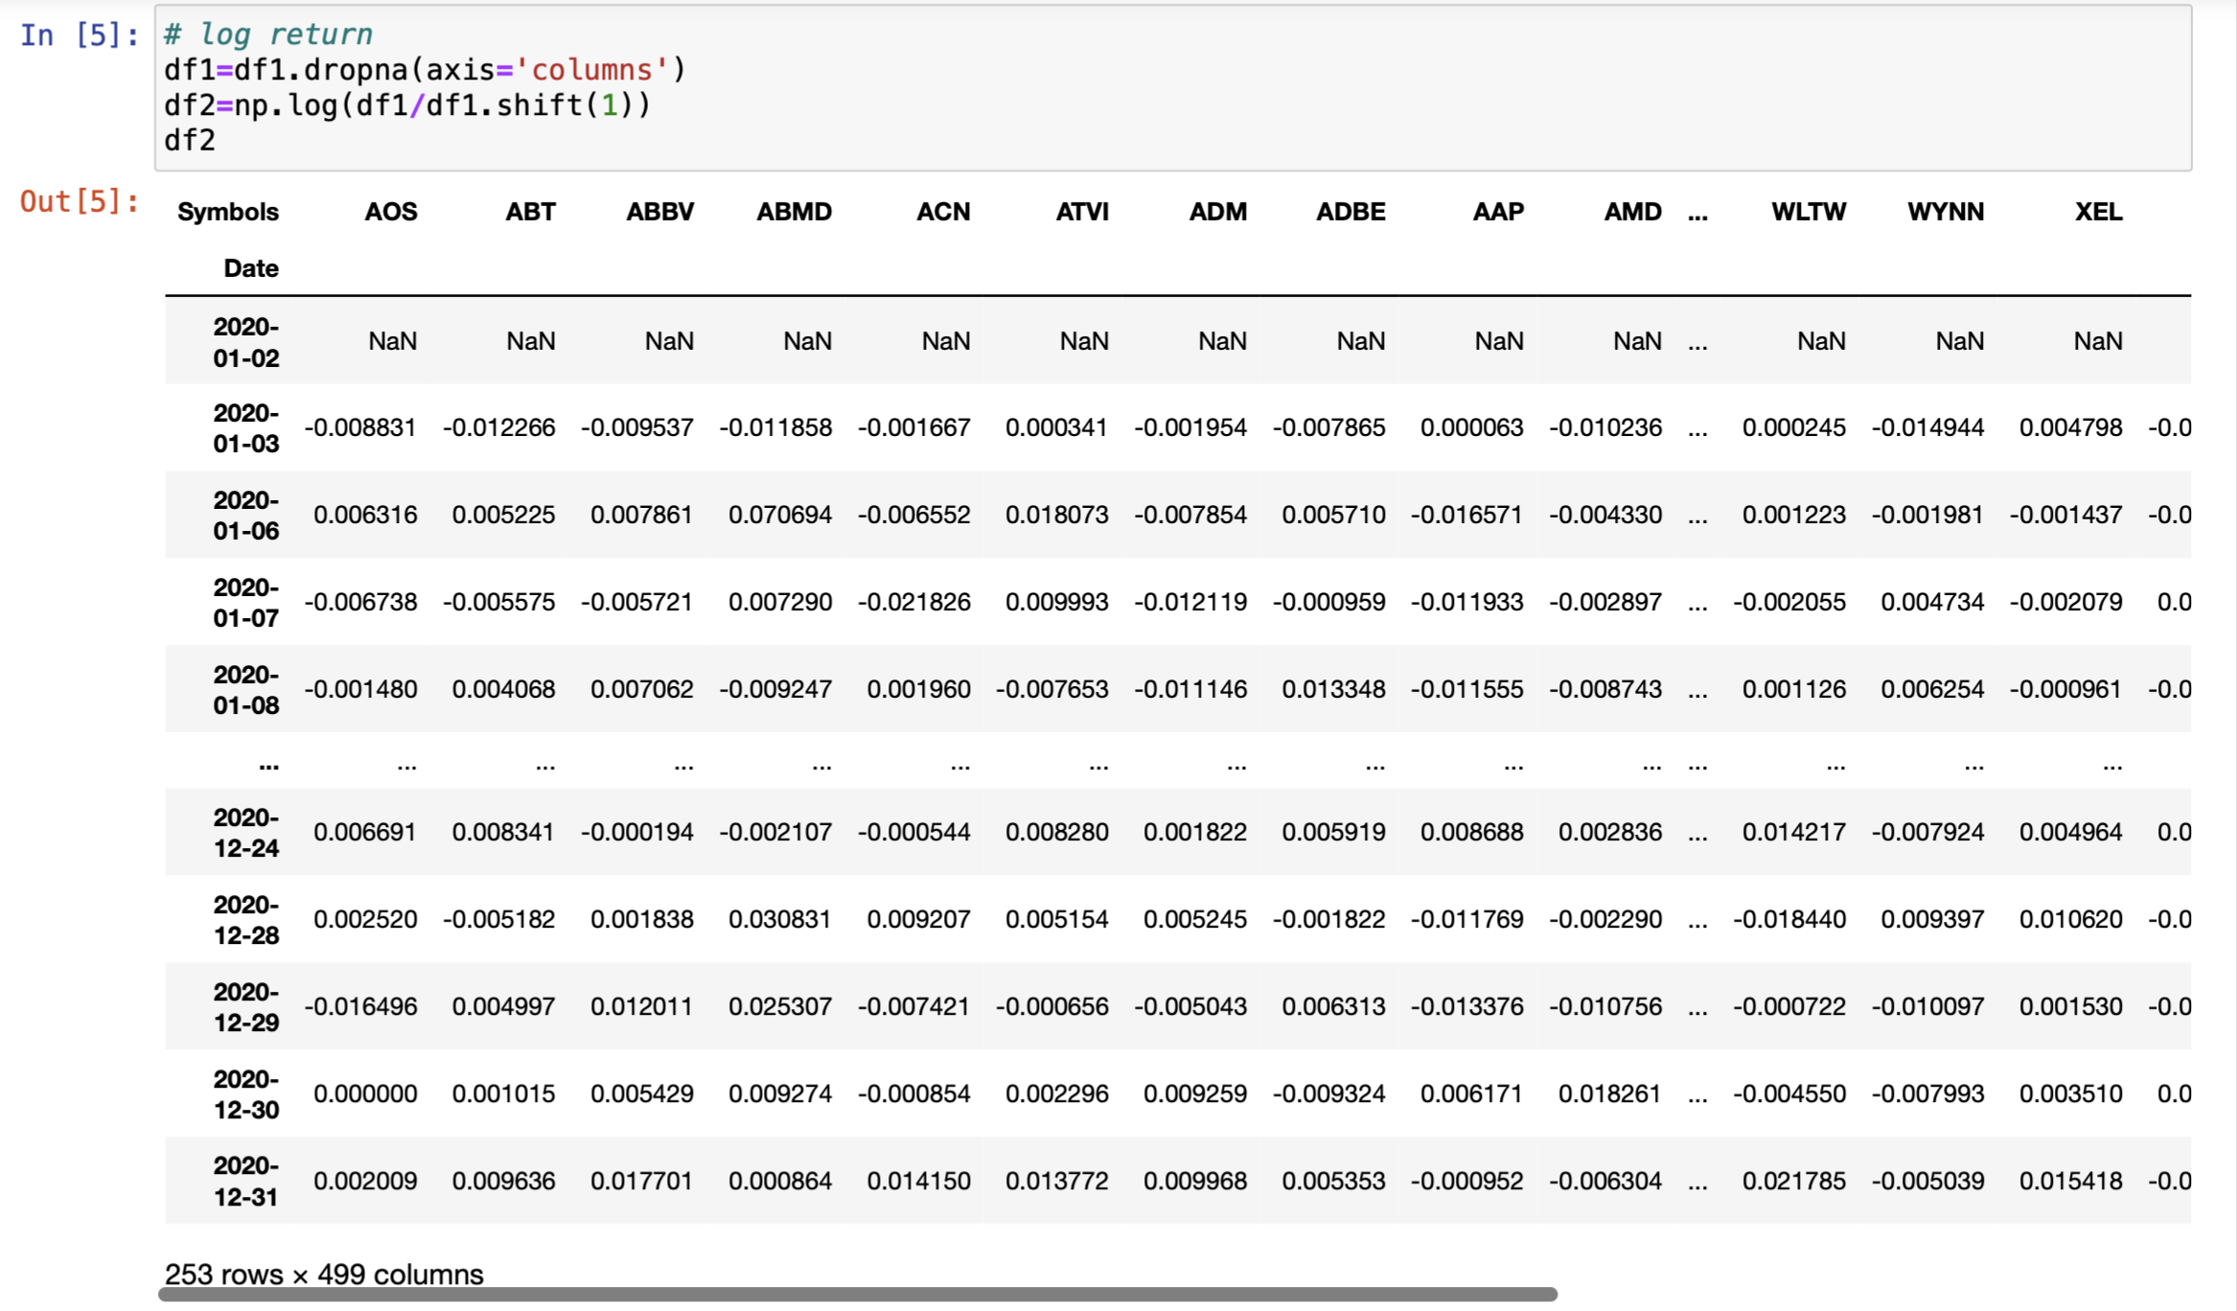
Code Explanation --- First Part

Slide 11
Code Explanation
The Code Process
First Step
Second Step
Third Step
Reading csv file of all component stocks in S&P500, converting values to a list
Retrieving data for S&P500 stocks from Yahoo Finance.
Computing log returns, dropping NaN, and creating a dataframe of cumulative log returns.
Forming equal weighted portfolio
Creating a Numpy array named a1 and populate it with equal weights
Defining a function portfolio with one input parameter a1 (array of weights), that will return:
- annualized portfolio return
- annualized portfolio standard deviation
- sharpe ratio
Defining an objective function named neg_sharpe(weight) and sum_weight(weight)
Setting lower and upper bounds of each weight
Finding x to minimize the objective function
Finding ret, std, and sharpe ratio of the optimal portfolio
Plotting the weight dataframe to a bar plot

Slide 12
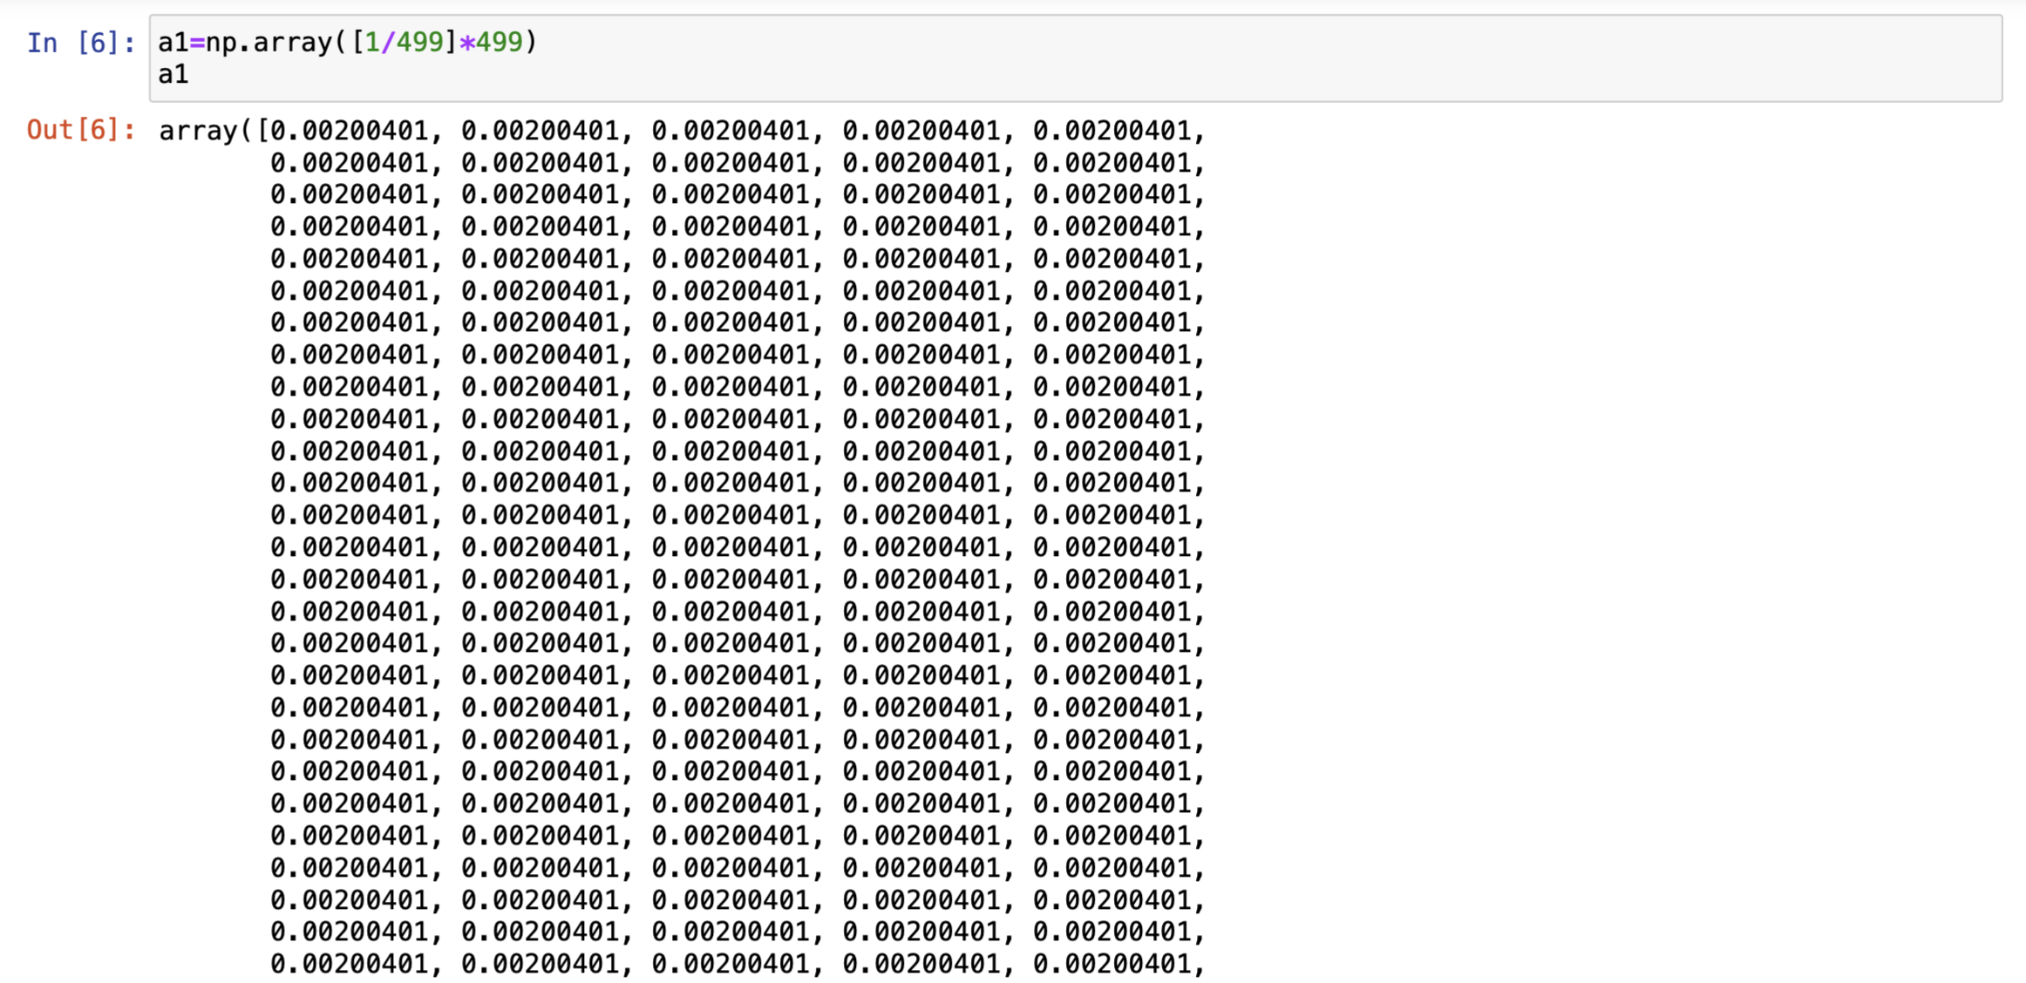
Code Explanation --- Second Part

Slide 13
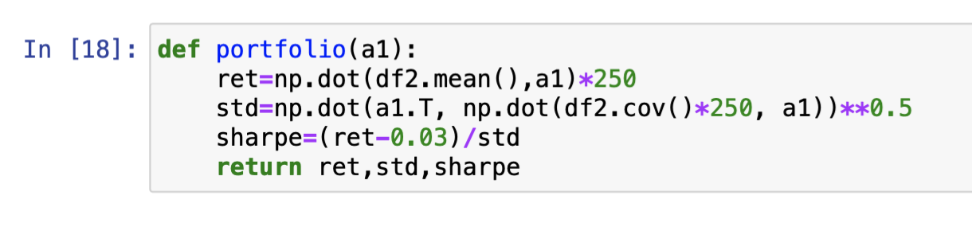
Code Explanation --- Second Part

Slide 14
Code Explanation
The Code Process
First Step
Second Step
Third Step
Reading csv file of all component stocks in S&P500, converting values to a list
Retrieving data for S&P500 stocks from Yahoo Finance.
Computing log returns, dropping NaN, and creating a dataframe of cumulative log returns.
Forming equal waited portfolio
Creating a Numpy array named a1 and populate it with equal weights
Defining a function portfolio with one input parameter a1 (array of weights), that will return:
- annualized portfolio return
- annualized portfolio standard deviation
- sharpe ratio
Defining an objective function named neg_sharpe(weight) and sum_weight(weight)
Setting lower and upper bounds of each weight
Finding x to minimize the objective function
Finding ret, std, and sharpe ratio of the optimal portfolio
Plotting the weight dataframe to a bar plot

Slide 15
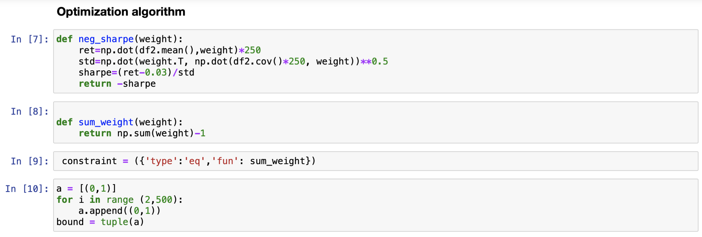
Code Explanation --- Third Part

Slide 16
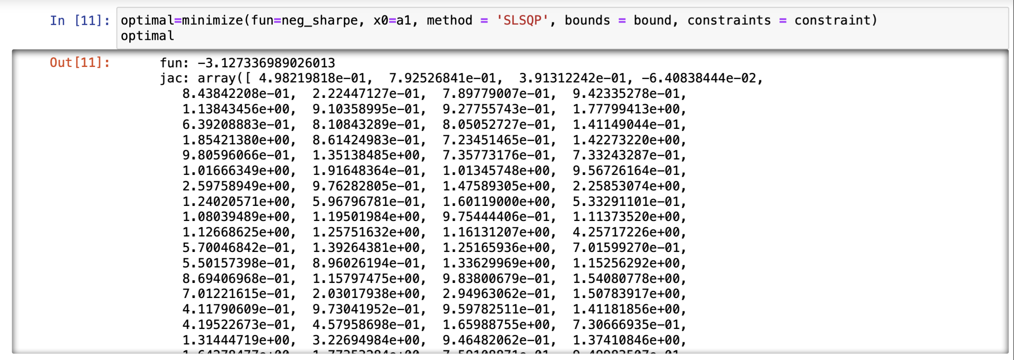
Code Explanation --- Third Part

Slide 17
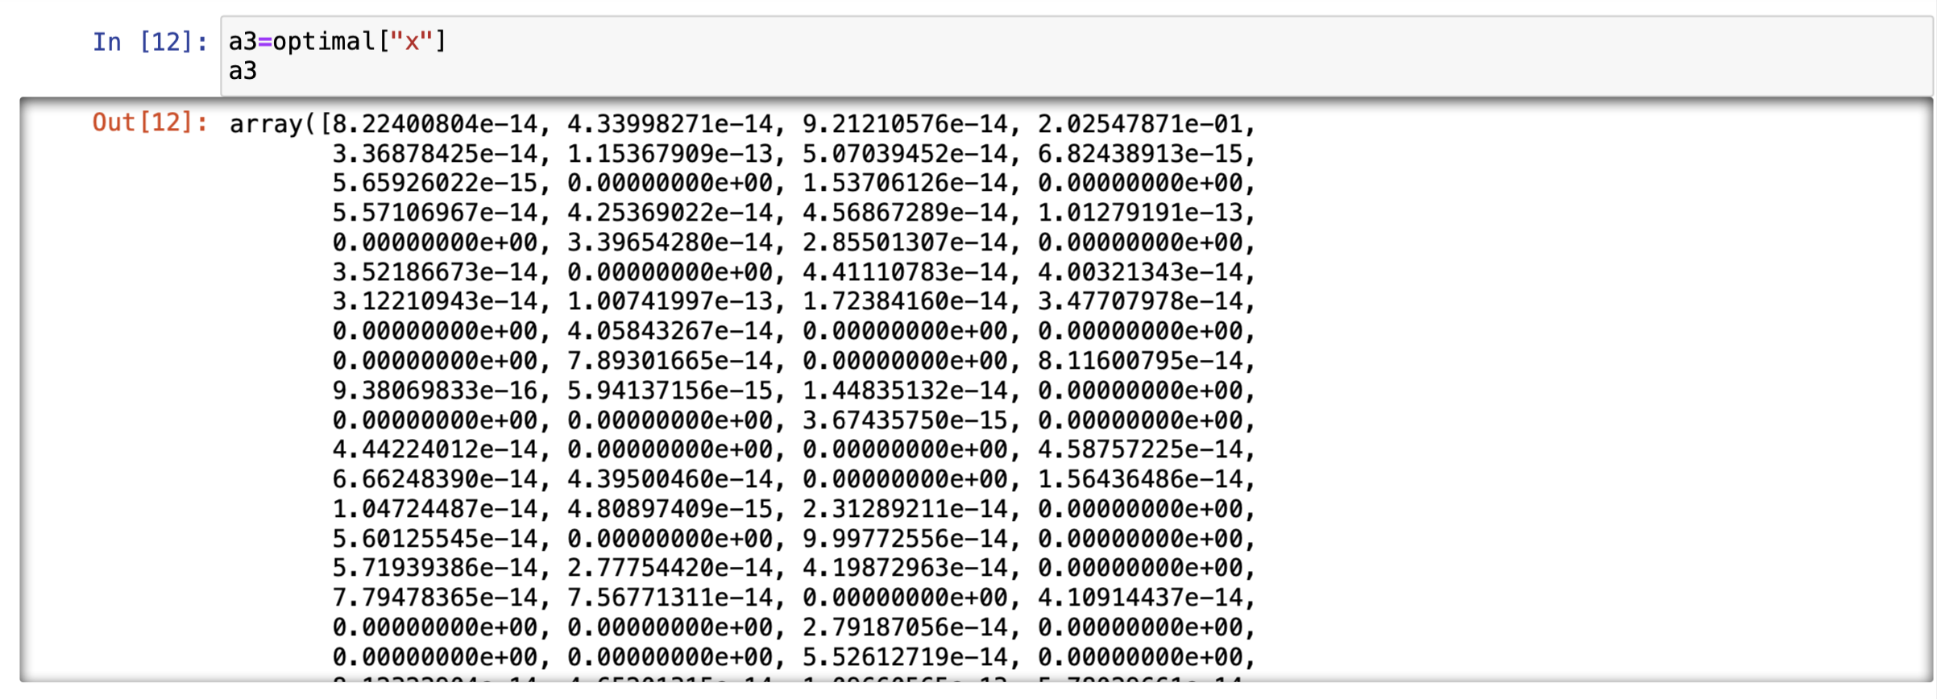
Code Explanation --- Third Part

Slide 18
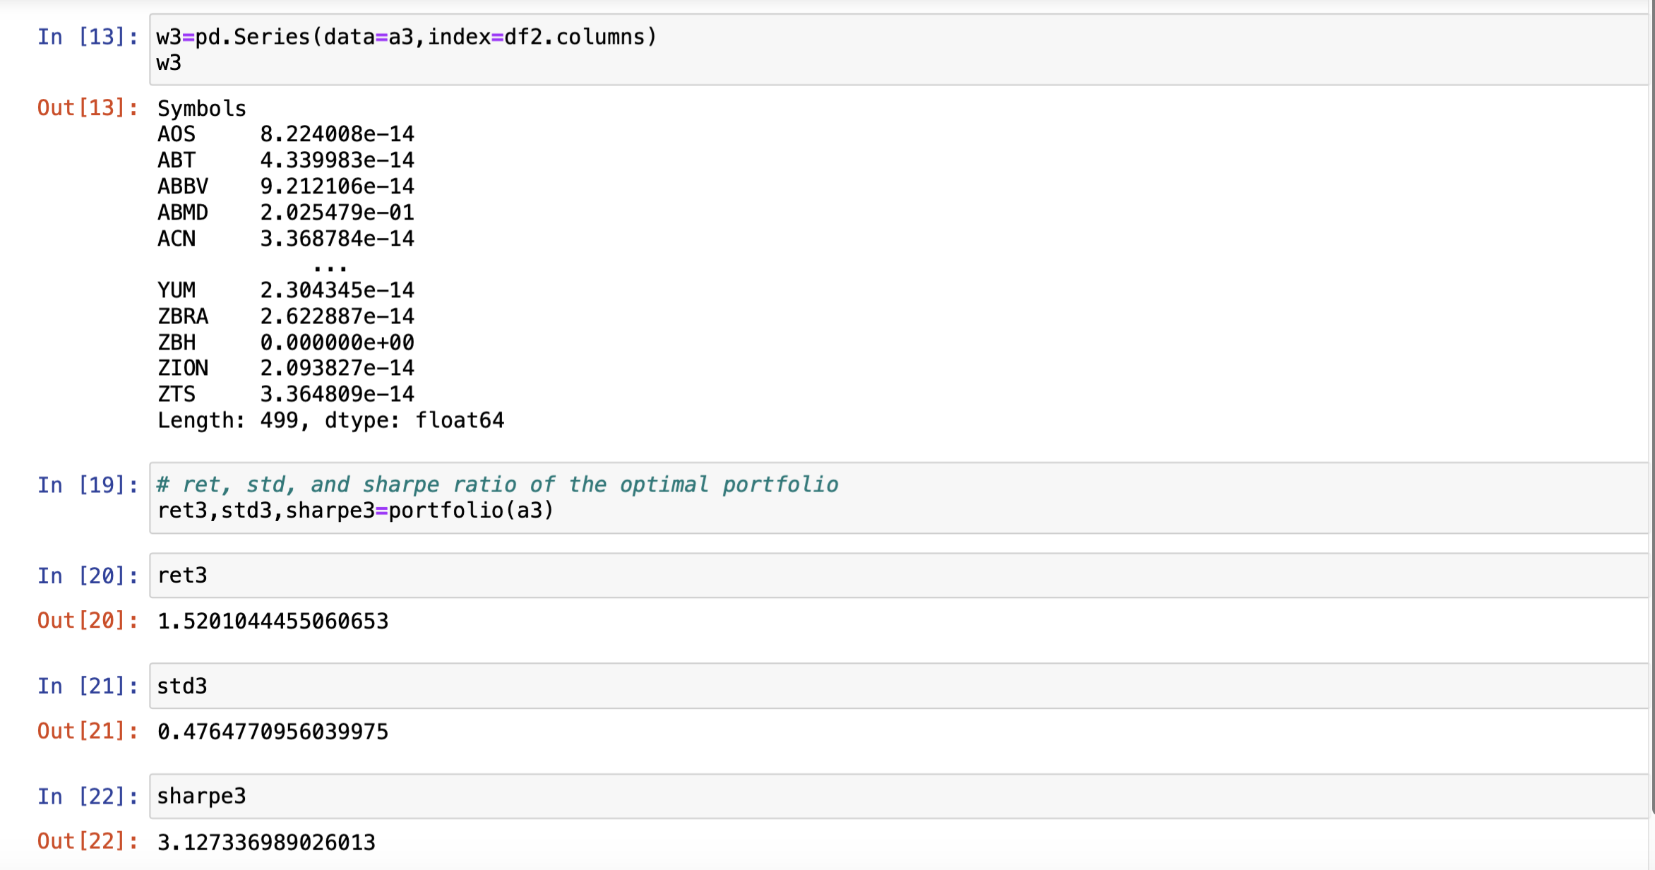
Code Explanation --- Third Part

Slide 19
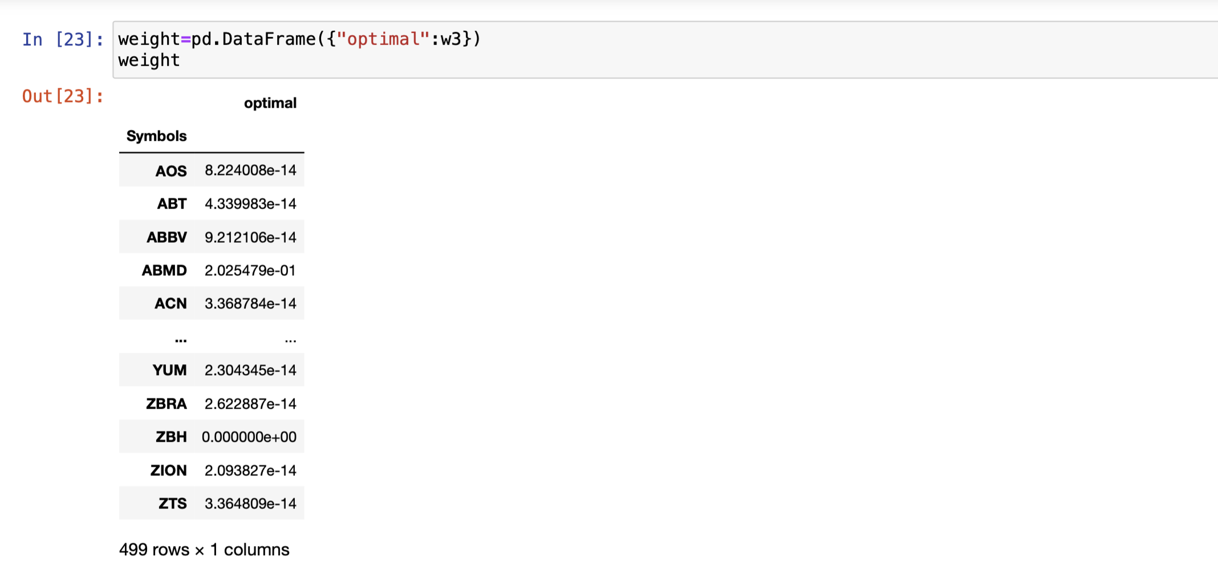
Code Explanation --- Third Part

Slide 20
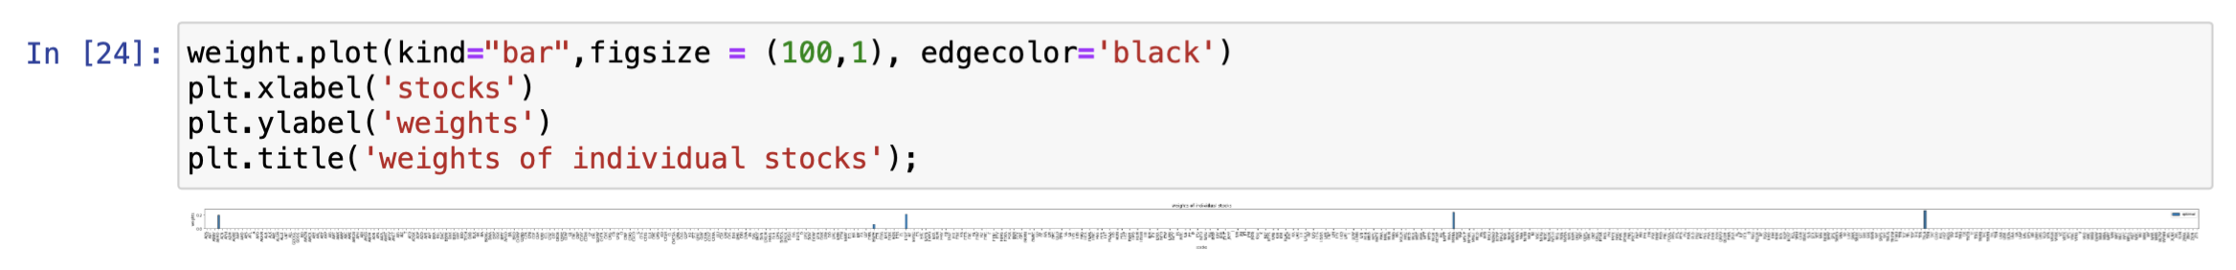
Code Explanation --- Third Part

Slide 21
Result

Slide 22
Result --- Return, std and Sharpe ratio

Slide 23
Result --- Portfolio

Slide 24
Conclusion

Slide 25
Conclusion
The industry chosen by the algorithm match the sectors that have been popular in the market, indicating that Sharp target and historical covariance can be used to analyze market trend.
A good Sharpe ratio does not necessarily depend on a high degree of diversification.
The optimization algorithm is based on historical data, and when using Sharp as a single target, the result may be less realistic and difficult to help with investment decisions, but it is an excellent tool for observing markets and analyzing portfolio performance and structure.

